Slide 1
Chemical Bonds
Unit 3A

Slide 2
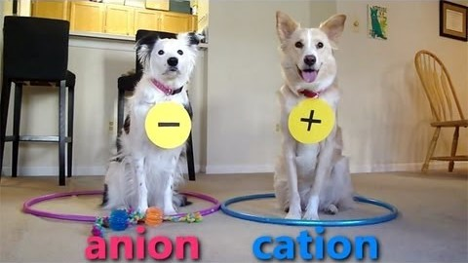
Part 1 – Ionic Bonding

Slide 3
Stable Electron Configurations
When the highest occupied energy level of an atom is filled with electrons, the atom is stable and not likely to react
Noble gases are stable (have 8 valence electrons)
  Argon: Greek work argos, means “idle” or “inert”
Chemical properties depend on the number of valence electrons

Slide 4
Stable Electron Configurations
Electron dot diagram- a model of an atom in which each dot represents a valence electron
  The symbol in the center represents the nucleus and all other electrons in the atom

Slide 5
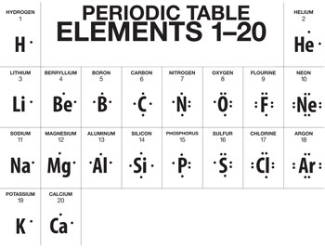
Stable Electron Configurations

Slide 6
Ionic Bonds
Elements that do not have complete sets of valence electrons tend to react, which allows them to achieve electron configurations similar to noble gases.
Some elements achieve stable electron configurations through the transfer of electrons between atoms

Slide 7

Ionic Bonds
Transfer of Electrons
Chlorine has one electron fewer than an argon atom
If Cl gains a valence electron, it will have the same stable electron arrangement as argon
Sodium has one valence electron (1 electron more than Neon)
If sodium lost this electron, its highest occupied energy level would have 8 electrons
Na would then have the same stable electron arrangement as neon
At the atomic level: an electron is transferred from each Na atom to a Cl atom; each atom ends up with a more stable electron arrangement than it had before the transfer

Slide 8
Ionic Bonds
Formation of Ions
When an atom gains or loses an electron, the number of protons is no longer equal to the number of electrons.
Charge on atom is neither balanced nor neutral
Ion- an atom that has a net positive or negative electric charge
Charge is represented by a plus or a minus sign

Slide 9
Ionic Bonds
Formation of Ions
Naming
Cl gains electron
  Has 17 protons and 18 electrons
  Ion has -1 charge because of the 1 extra electron
  Cl¹⁻ or Cl⁻
Na gains electron
  Has 11 protons and 10 electrons
  Ion has +1 charge because of the extra proton
  Na¹⁺ or Na⁺
Anion- ion with a negative charge
  Named: element name plus suffix –ide
  Cl⁻ : chloride ion
Cation- ion with a positive charge
  Named: just use the element name
  Na⁺ : sodium ion

Slide 10
Ionic Bonds
Formation of Ionic Bonds
Remember: opposite charges attract
When an anion and cation are close together, a chemical bond forms between them
Chemical Bond- the force that holds atoms or ions together as a unit (one)
Ionic Bond- the force that holds cations and anions together
An ionic bond forms when electrons are transferred from one atom to another

Slide 11
Ionic Bonds
Ionization Energy
The lower the ionization energy, the easier it is to remove an electron from an atom
Ionization energies tend to increase from left to right across a period
Ionization energies tend to decrease from the top of a group to the bottom
Example: easier to remove an electron from K than from Na (K is more reactive than Na)
Cations form when electrons gain enough energy to escape from atoms
This energy allows electrons to overcome the attraction of the protons in the nucleus
Ionization Energy- the amount of energy used to remove an electron
Varies from element to element

Slide 12
Ionic Compounds
Compounds that contain ionic bonds are ionic compounds, which can be represented by chemical formulas.
Chemical Formula- a notation that shows what elements a compound contains and the ratio of the atoms or ions of these elements in the compound

Slide 13
Ionic Compounds
The chemical formula for sodium chloride is NaCl
From the formula, you can tell that there is one sodium ion for each chloride ion in sodium chloride

Slide 14

Ionic Compounds
What would be the formula for magnesium chloride?
Mg cannot reach a stable electron configuration by reacting with just one Cl atom, it must transfer electrons to two Cl atoms
Formula is: MgCl₂
Subscripts are used to show the relative numbers of atoms of the elements present (if only one atom of element, no subscript is needed)

Slide 15
Ionic Compounds
Crystal Lattices
Each chloride ion is surrounded by six sodium ions and each sodium ion is surrounded by six chloride ions
Crystals- solids whose particles are arranged in a lattice structure; classified into groups based on shape; shape depends on arrangement
The arrangement of the ions depends on the ratio of ions and their relative size
A chemical formula for an ionic compound tells you the ratio of the ions in the compound, but it doesn’t tell you how the ions are arranged in the compound.
Salt: pieces are shaped like cubes
This shape is a clue to how the sodium and chloride ions are arranged in the compound

Slide 16
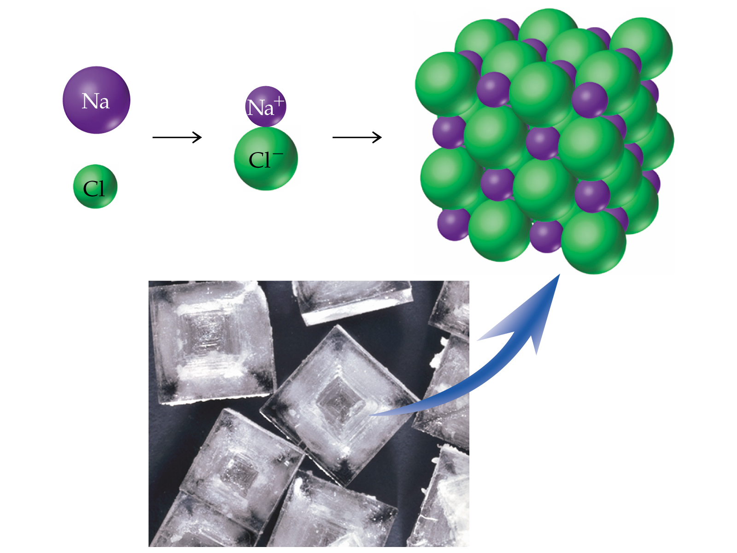
Ionic Compounds

Slide 17
Ionic Compounds
Properties of Ionic Compounds
High melting point
In solid state, poor conductor of electric current
When melted, good conductor of electric current
Solid crystals shatter when struck with hammer

Slide 18
Ionic Compounds
Properties of Ionic Compounds
The properties of an ionic compound can be explained by the strong attractions among ions within a crystal lattice
Recall: the arrangement of particles in a substance is the result of two opposing factors
  1. attractions among particles in the substance
  2. kinetic energy of the particles
The stronger the attractions among particles, the more kinetic energy the particles must have before they can separate.

